Slide 1
Team:
Research >> Intern
Members:
Vaibhav Garg (20171005)
Anchit Gupta (20171041)
Neel Trivedi (20171015)

Slide 2
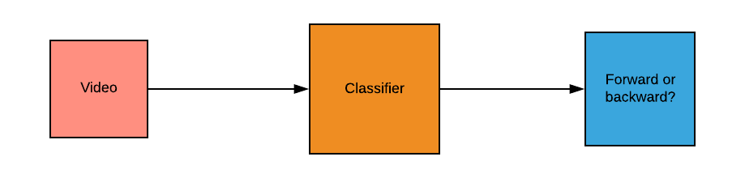
Seeing Arrow of Time
We explore whether we can observe Time’s Arrow in a temporal sequence–is it possible to tell whether a video is running forwards or backwards? We investigate this somewhat philosophical question using computer vision and machine learning techniques. We explore three methods by which we might detect Time’s Arrow in video sequences, based on distinct ways in which motion in video sequences might be asymmetric in time

Slide 3
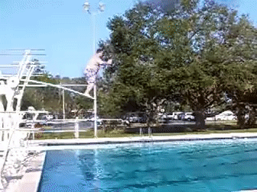
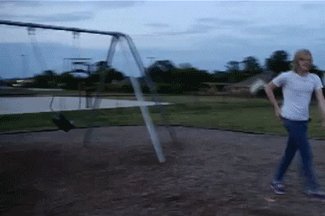
Basic Understanding
It is quite obvious that the above gif is forward in time and the below gif is backward in time. But what exactly are those features that capture this temporal information?
The paper aims to capture information from the underlying physics and phenomena like increase in entropy.

Slide 4
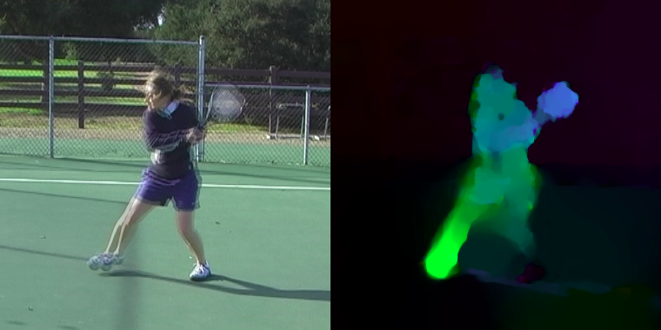
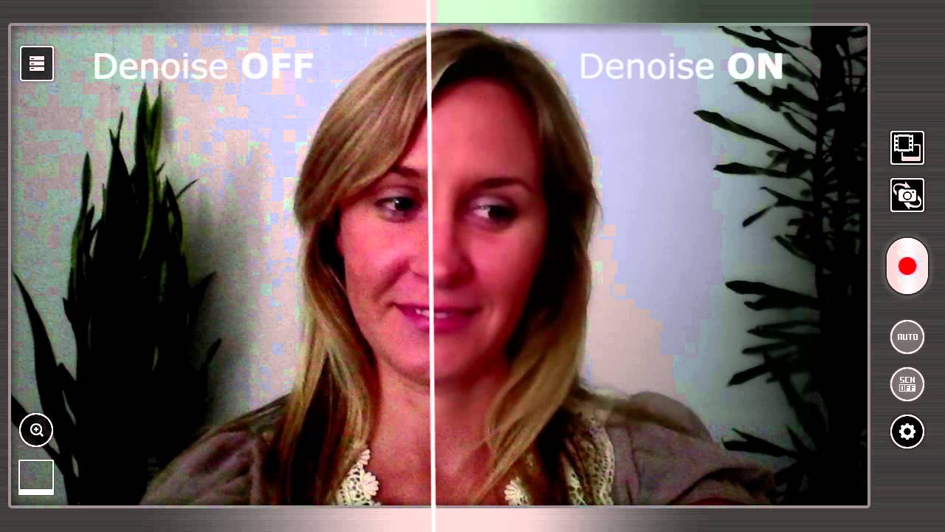
Major Applications:
Optical Flows
Video denoising
Filling the missing Frames
Predicting what happens next in an incomplete video-Essential task in robotics
And many more....

Slide 5
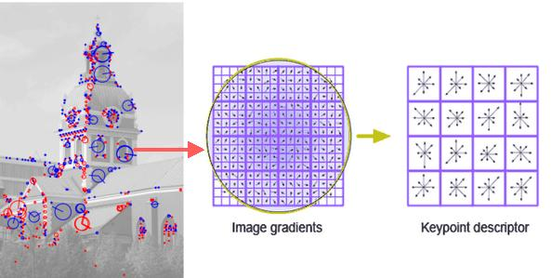
Flow-Words
Inspiration from SIFT features! Could there be a similar vector which could capture local temporal information?

Slide 6
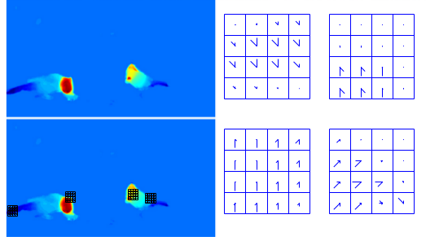
Flow based words method
Flow words are SIFT like features which capture local regions of motion in a video so that we can examine which types of motion exhibit temporal asymmetries that might be useful for detecting the Arrow of Time.

Slide 7
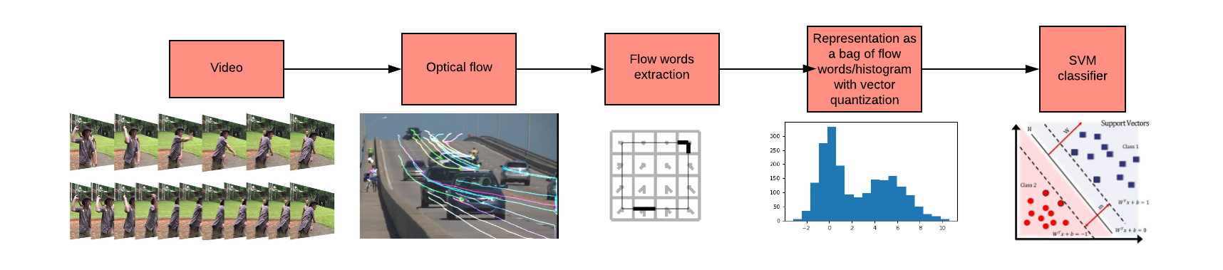
Main pipeline
Detailed steps present in next slide

Slide 8
Steps:
We first split the video into frames.
For a given frame, we register its next and previous frame to account for camera motion and panning.
Optical flow is computed between these registered frames.
Using optical flow, flow-words are sampled along with some kind of thresholding.
Steps 2 to 3 are done for every frame, giving quite an extensive list of flow words per video.
We apply K-Means clustering in order to vector-quantize flow words from all the videos.
Each video is then represented as a bag-of-flow-words(normalized histogram) and used as a feature vector for SVM training.

Slide 9
Lucas Kanade Optical Flow implementation
One of the major component of the pipeline of this project is to find the optical flow in the given video.
We implemented the Lucas Kanade method to find the optical flow between frames
Lucas Kanade method takes the intensity difference at given pixel across the frame to find the optical flow in the given frame sequence.

Slide 10
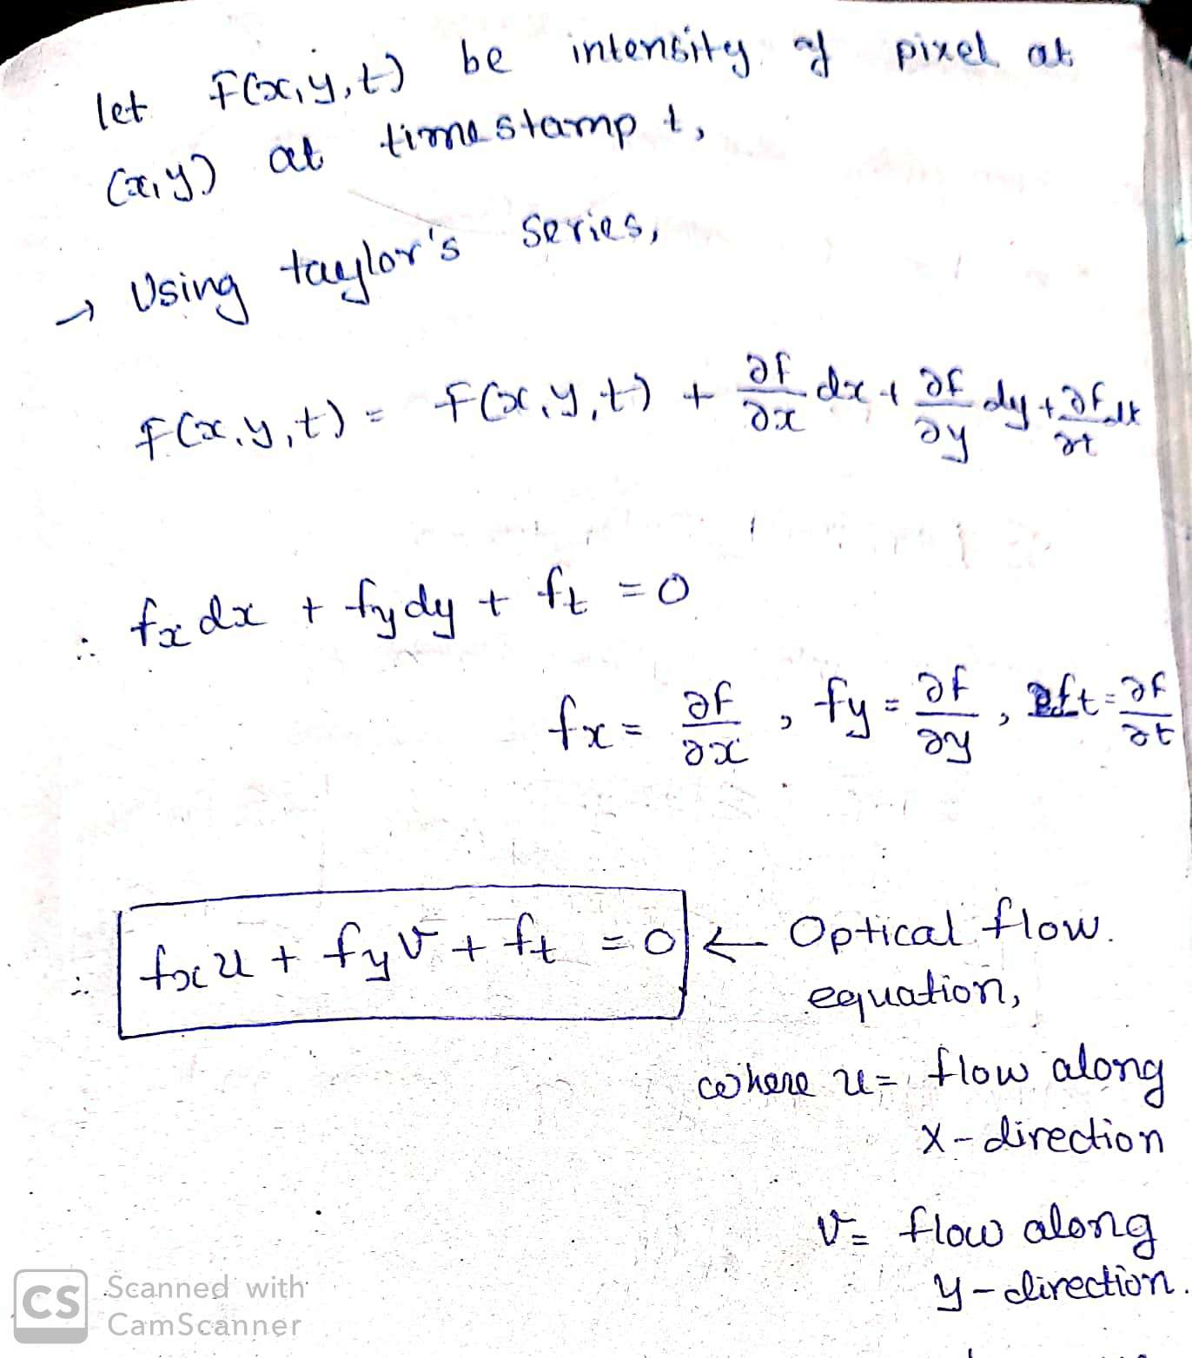
Lucas Kanade Algorithm

Slide 11
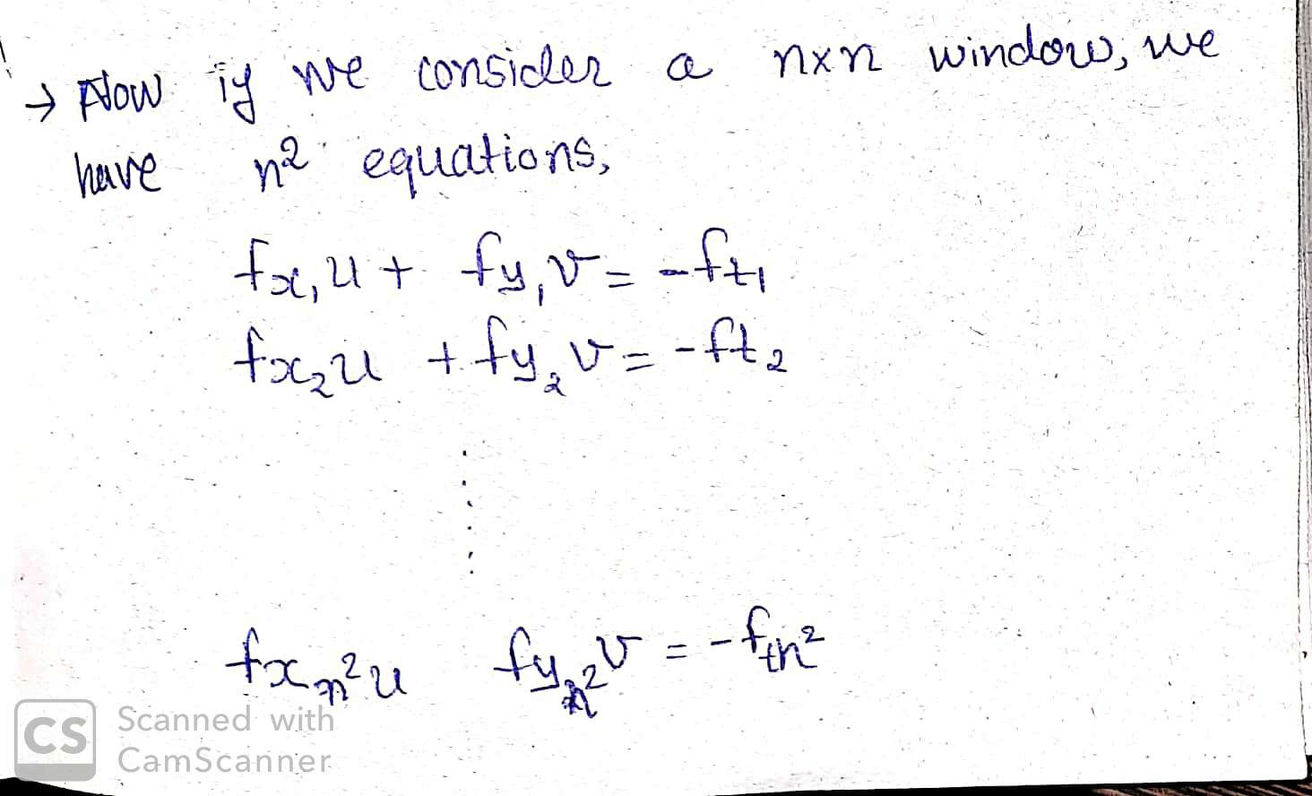

Slide 12
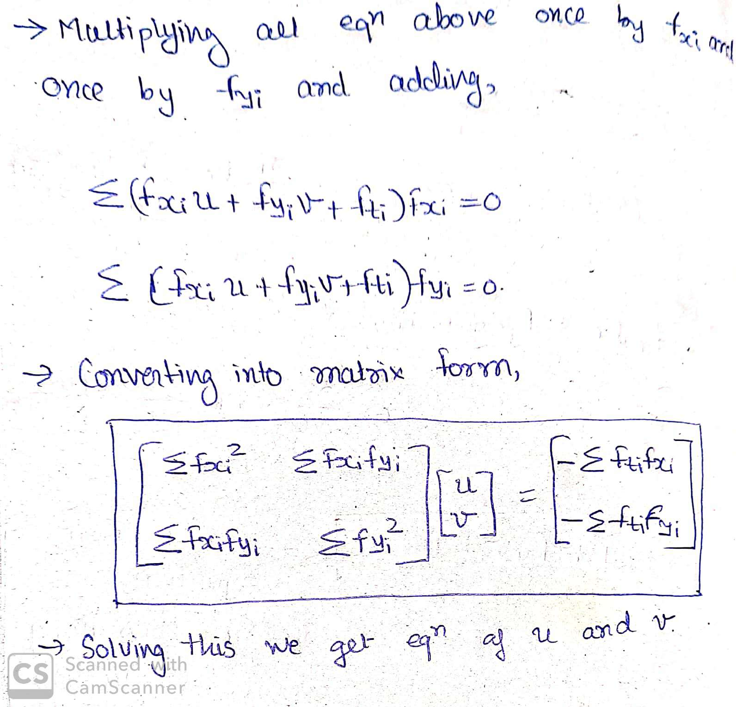

Slide 13
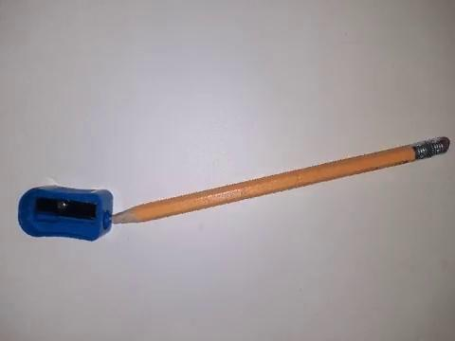

Results of Lucas Kanade

Slide 14
Classification Experiments

Slide 15
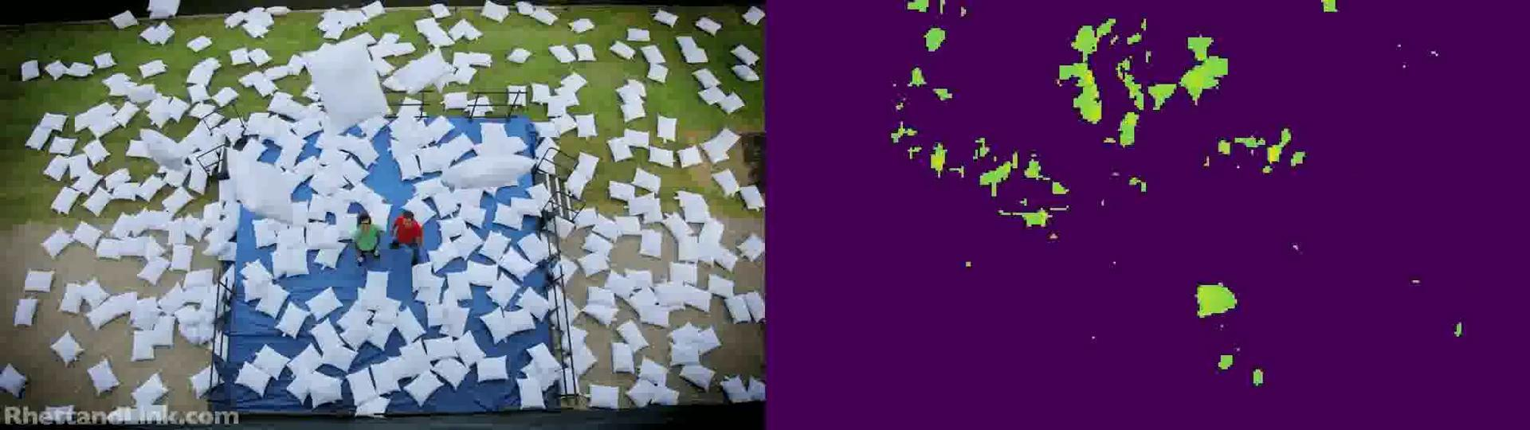
Fixed Thresholding
We tried different values of threshold for L2 norm of patches ranging from 1000 to 2000.
Problem with the lower threshold was that it gave too many patches which was difficult to store and process.
Problem with the higher threshold was that it gave too few patches. And 0 patches for many videos.
So the best value for the same was selected as 1300 as it gave the optimal number of patches ( O(10⁷) ) as mentioned in the paper.
Accuracy achieved by this method: 65%

Slide 16
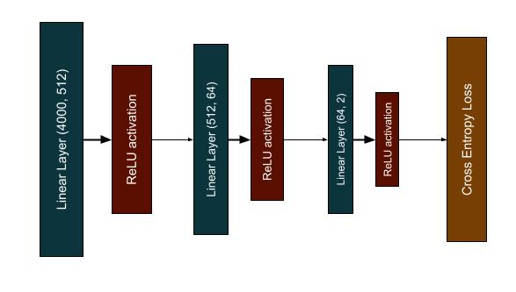
MLP
We tried to train a Multilayer perceptron classifier for our data as well.
The architecture of the MLP was simple as shown below,

Slide 17
We used SGD as our optimizer and a batch size of 8
We divided the training data into train and validation split with training data having 400 samples and validation data having 62 samples
Our testing data already had 236 samples.
The results we achieved for this classifier after training the MLP:
Training Accuracy : 85.5%
Validation Accuracy : 53.22%
Testing Accuracy : 55.08%
The reason for low testing accuracy is the small amount of data and overfitting of the model on the training set.

Slide 18
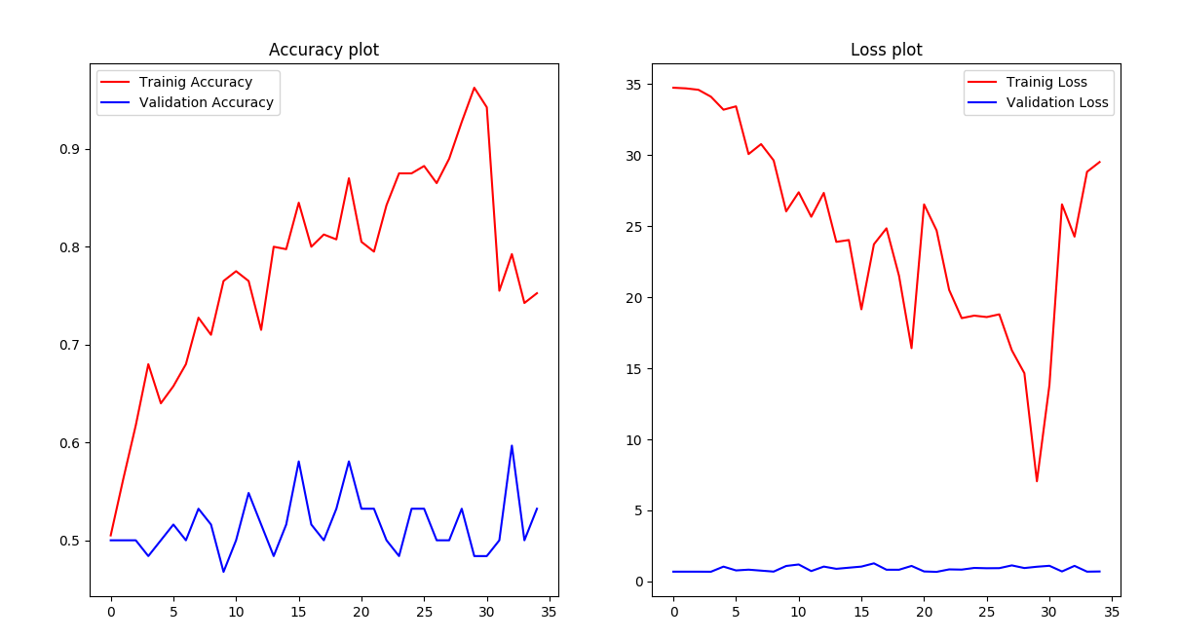

Slide 19
KNN
For the baseline experiments we also tried using the K-nearest neighbour algorithm (with k = 3) to classify the videos.
Initial results were 74% accuracy on training data and 1.6% on testing data. The reason for such low accuracy is the very high dimensions of input data (4000 length histograms)
Hence we tried to reduce the dimensions of the data using PCA and reduced it to 10 and we were able to get accuracy of 17% on testing data. The reason for such low accuracy even after the dimensionality reduction is the inherent complexity of data and hence simple models like KNN can not easily classify the data.

Slide 20
Adaptive Thresholding
To eliminate the dependency of thresholding we tried Adaptive thresholding.
To have an order of 10⁷ patches, 100 patches with the greatest norm were selected from each frame of every video for 4 different orientations of videos mentioned in the paper.
Accuracy achieved: 55%

Slide 21
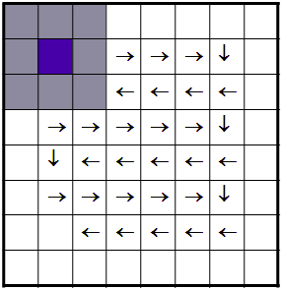
Different Window size
One of the reasons we believed we couldn’t get accuracies as good as the paper was that our window size was too small. So we also ran an iteration with a window size=24.
But since the flow-word size now increased significantly, we also had to increase the stride length significantly to 16.
Accuracy achieved: 52%
We believe the reason for such a bad accuracy could be due to very less number of total-flow words sampled, since only O(10⁵) flow-words were achieved in total, a very low number of flow-words per video are not good enough to represent the video.

Slide 22
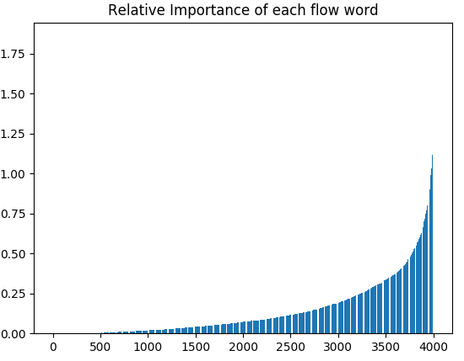
Deeper Analysis (using SVM)
As you can see from the graph, there is a very clear spectrum showing how some flow-words are way more important than any other. In the same way, how some words are more important than others in a text document. But what are these important flow-words?

Slide 23
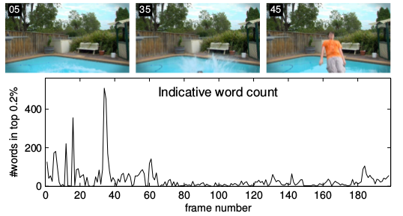
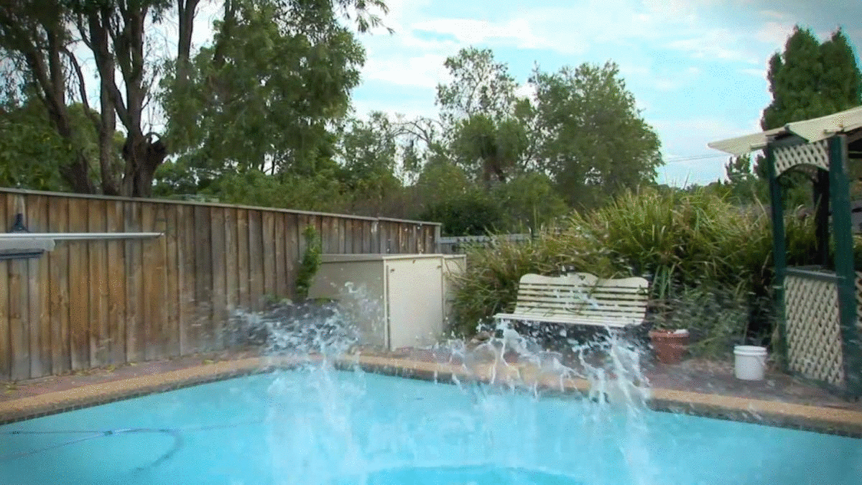
Deeper Analysis (using SVM)
As mentioned earlier, the important flow-words in fact turned out to be the ones corresponding to motion like a splash of water. Such motion is the one which is most indicative in the classification process.

Slide 24
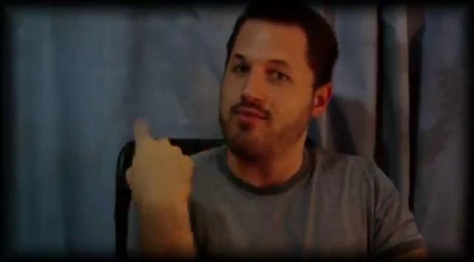
Results demo
Correct Prediction samples:

Slide 25
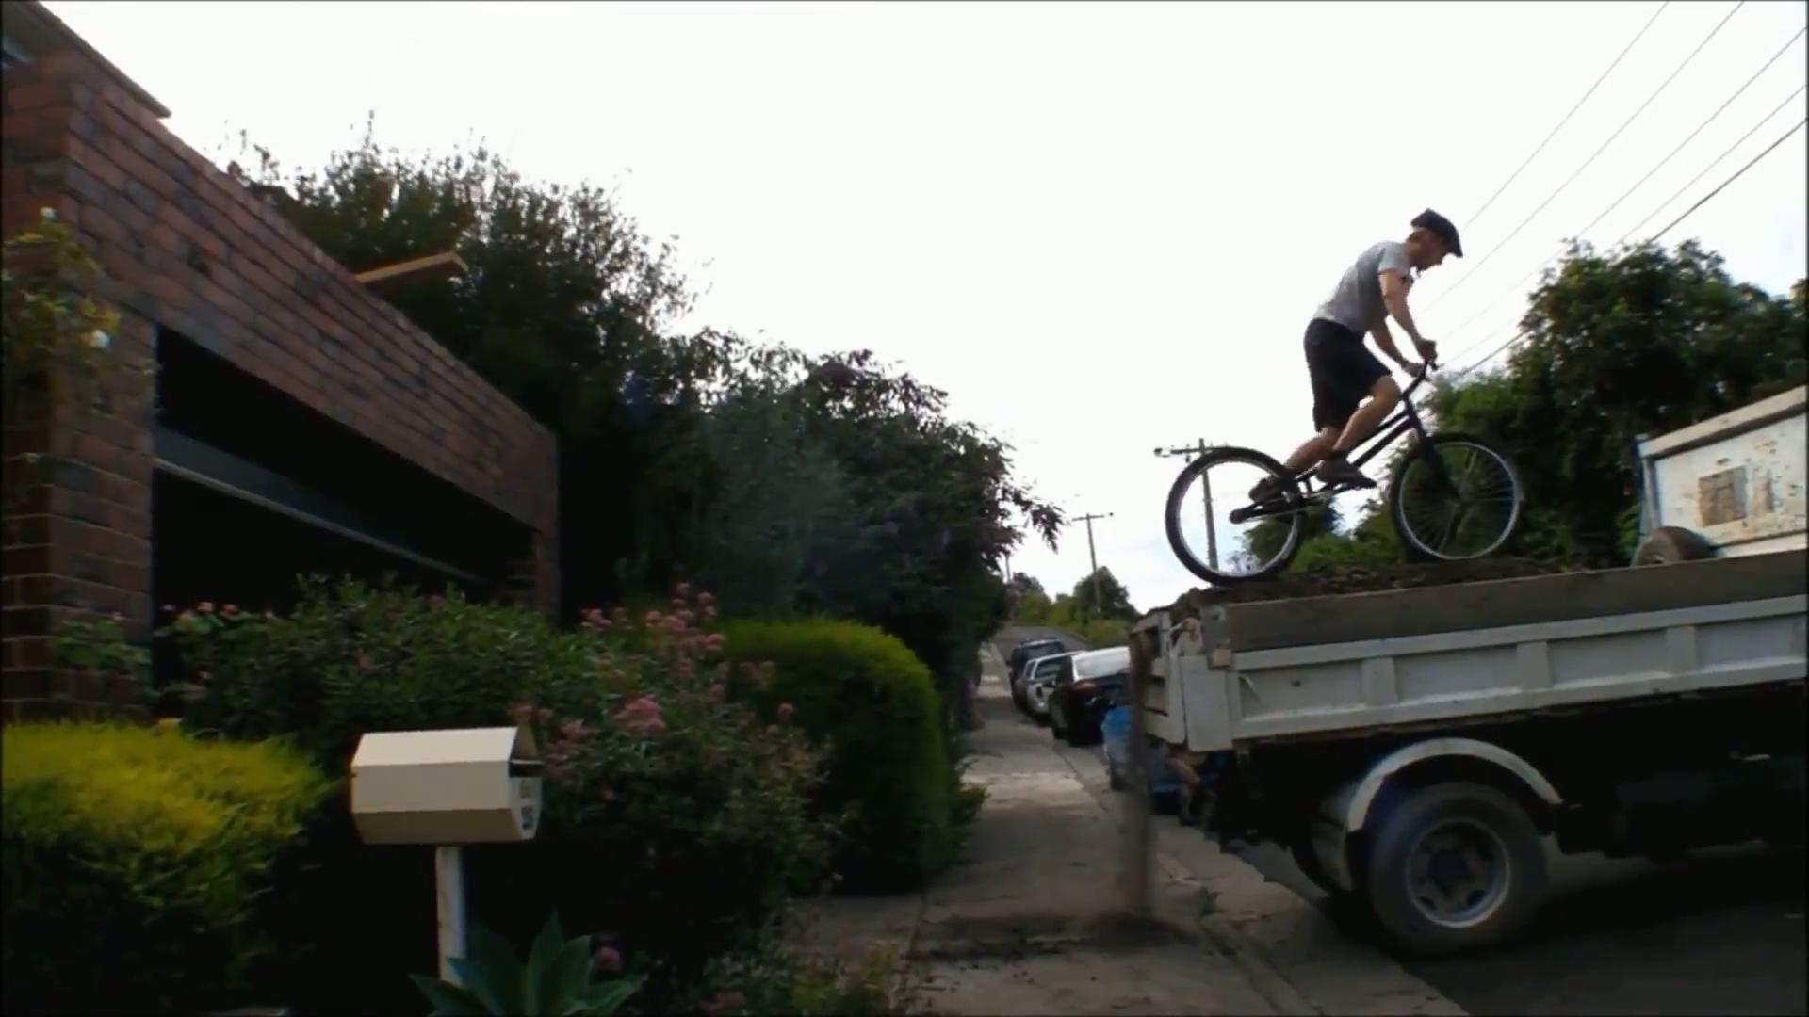
Incorrect Prediction sample

Slide 26
Okay… That’s it.
Thank You.

